Slide 1
AEM 2210
Financial Accounting
Chapter 12: Statement of Cash Flows
Professor Sinclair
Spring 2018

Slide 2
Chapter 12 Learning Objectives
Classify cash flow statement items as part of net cash flows from operating, investing, and financing activities
Report and interpret cash flows from operating activities using the indirect method
Analyze and interpret the quality of income ratio
Report and interpret cash flows from investing activities
Analyze and interpret the capital acquisitions ratio
Report and interpret cash flows from financing activities
Understand the format of the cash flow statement and additional cash flow disclosures

Slide 3
Cash Flow
Clearly, net income is important, but cash flow is also critical to a company’s success.
Positive cash flow permits a company to expand operations, replace worn assets, take advantage of new investment opportunities, and pay dividends to its owners.
Both managers and analysts need to understand the various sources and uses of cash that are associated with business activity.
The statement of cash flows focuses attention on a firm’s ability to generate cash internally, its management of current assets and current liabilities, and the details of its investments and its external financing. Wall Street analysts consider cash flow an important indicator of a company’s financial health.

Slide 4
Significant Estimates in Financial Reporting

Slide 5
Significant Estimates in Financial Reporting
Receivables:
Uncollectible receivables
Allowance for loan reserves
Uncollectible pledges
Inventories:
Obsolete inventory
Net realizable value of inventories where future selling prices and future costs are involved
Losses on purchase commitments
Financial instruments:
Valuation of securities
Trading versus available-for-sale classification
Probability of high correlation of hedge
Sales of securities with puts and calls

Slide 6
Significant Estimates in Financial Reporting
Productive facilities, natural resources and intangibles:
Useful lives and residual values
Depreciation and amortizable methods
Recoverability of costs
Recoverable reserves
Accruals:
Property and casualty insurance company loss reserves
Compensation in stock option plans and deferred plans
Warranty claims
Taxes on real and personal property
Renegotiation refunds
Actuarial assumptions on pension plans (i.e., expected rate of return, discount rates)
Litigation:
Probability of loss
Amount of loss

Slide 7
Significant Estimates in Financial Reporting
Revenues:
Airline passenger revenue
Subscription income
Freight and cargo revenue
Dues income
Loss on sales contracts
Contracts:
Revenue to be earned
Costs to be incurred
Percent of completion
Leases:
Initial direct costs
Executory costs
Residual values

Slide 8
Significant Estimates in Financial Reporting
Rates:
Annual effective tax rate in interim reporting
Imputed interest rates on receivables and payables
Gross profit rates under program method of accounting
Other:
Losses and net realizable value on disposal of segment or restructuring of a business
Fair values in nonmonetary exchanges
Interim period costs in interim reporting
Current values in personal financial statements

Slide 9
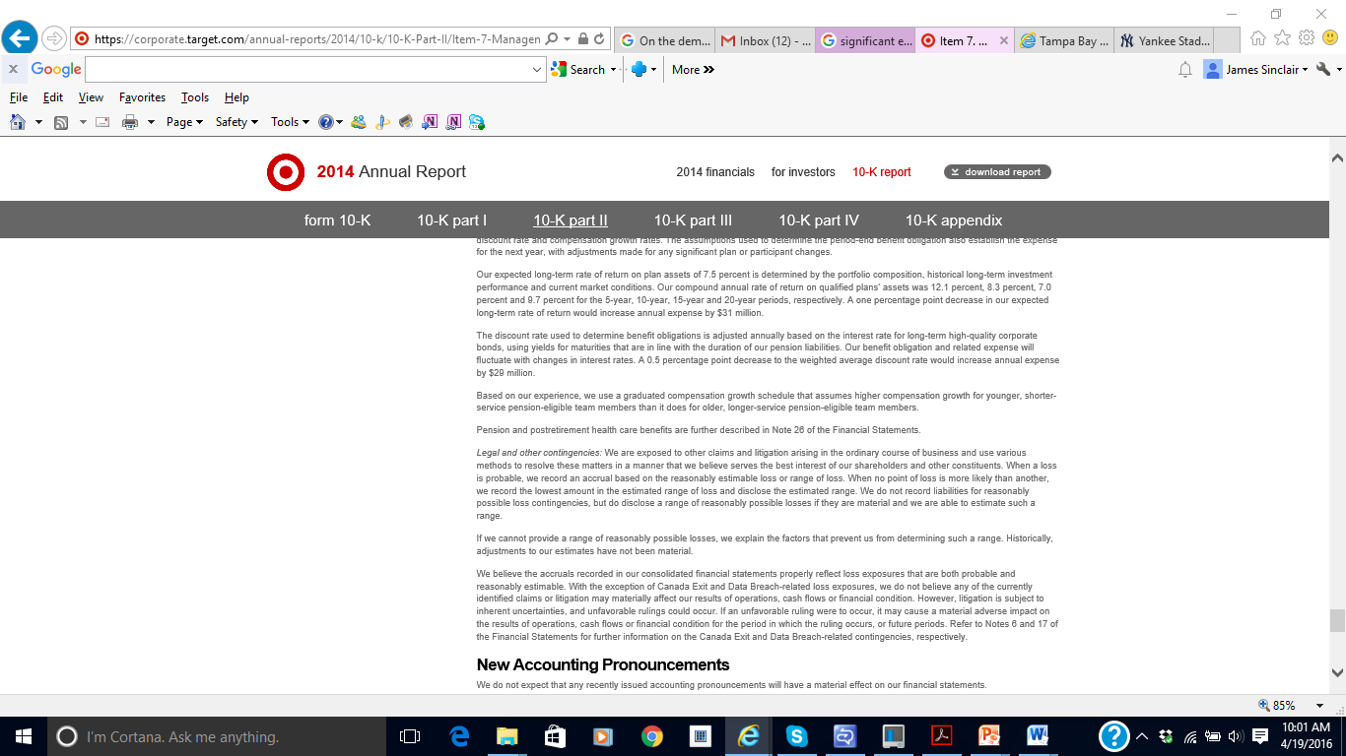
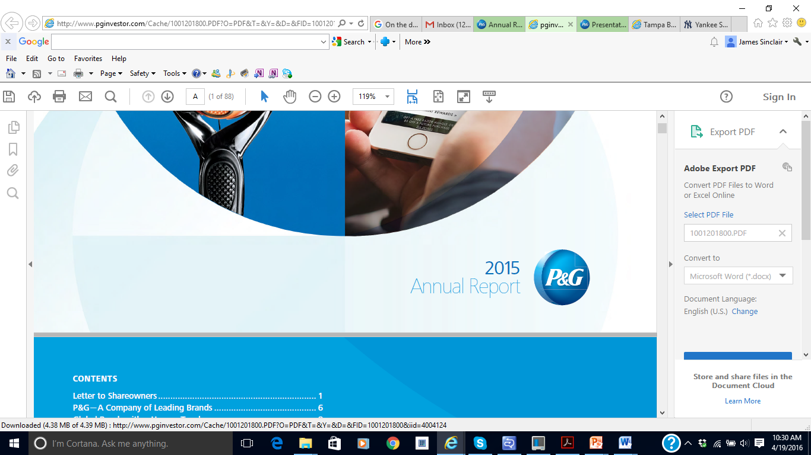
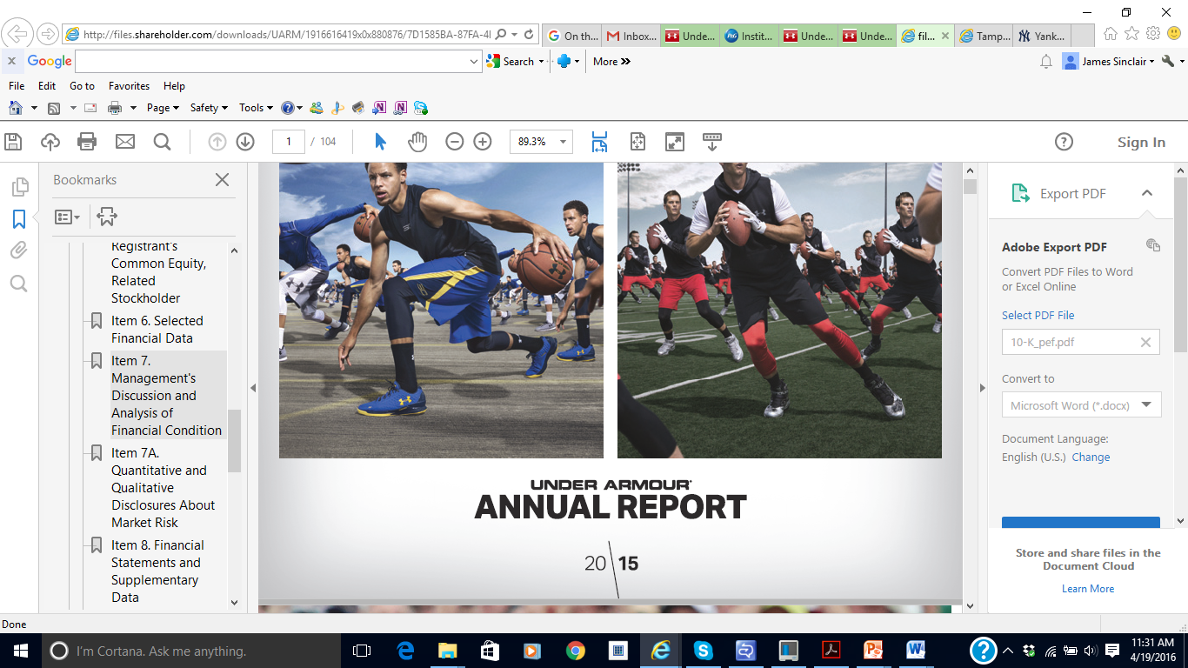
Critical Accounting Policies and Estimates
Target Corporation:
Inventory and Cost of Sales
Vendor income receivable
Long-lived assets
Investments in and receivables from Canada Subsidiaries
Insurance/self-insurance
Income taxes
Pension and postretirement health care accounting
Legal and other contingencies
Proctor & Gamble:
Income taxes
Employee benefits
Goodwill and intangible assets
Under Armour:
Revenue recognition
Allowance for doubtful accounts
Inventory Valuation and Reserves
Goodwill, Intangible Assets and Long-Lived Assets
Stock-Based Compensation

Slide 10
Balance Sheet, Income Statement, Statement of Cash Flows:
Accrual Anomaly

Slide 11
Accrual Example
Peter starts his business by buying $100 of lemonade; $10 of cups; and rents a lemonade stand for $10/day
Total cost = $120 (paid entirely with cash)
By end of day, Peter sells all of his lemonade and used all of his cups. All customers paid in cash.
Total cash proceeds = $200
Income Statement Balance Sheet Cash Flow Statement
Revenue 200 Assets Beg. End Cash from operations
Expenses Cash 120 200 Cash revenue 200
Lemonade 100 Inventory purchase (110)
Cups 10 Rental stand ( 10)
Rental stand 10 Total CFO 80
Total expenses 120 Total Assets 120 200
Net Income 80
Cash component of net income 80
Accrual component of net income 0

Slide 12
Accrual Example
Paul starts his business by buying $1,000 of lemonade; $100 of cups; and buys a lemonade stand for $1,000. He expects the stand will be used for 100 days.
Total cost = $2,100 (paid entirely with cash)
By end of day, Paul sells 10% of his lemonade and used 10% of his cups. Paul generated $200 in revenue, but half of his customers were short on cash and agreed to come back the next day to pay.
Income Statement Balance Sheet Cash Flow Statement
Revenue 200 Assets Beg. End Cash from operations
Expenses Cash 2,100 100 Cash sales 100
Lemonade 100 A/R 100 Inventory purchase (1,100)
Cups 10 Inventory 990 Total CFO (1,000)
Rental stand 10 PP&E 990 Cash from investing
Total expenses 120 Total Assets 2,100 2,180 Purchase of stand (1,000)
Net Income 80 Total change in cash (2,000)
Cash component of net income (2,000)
Accrual component of net income 2,080

Slide 13
Sloan (1996) Accrual Anomaly
Current Net Operating Assets
= (Current Assets – Cash) – (Current Liabilities – Short-term debt – Income taxes/P)
Similar to a broad definition of non-cash working capital
Accruals = Current Net Operating Assets (End of this year)
– Current Net Operating Assets (End of previous year)
Earnings = Accruals + Cash Flows
Basic proposition:
The accrual component of earnings is of lower quality than the cash flow component of earnings

Slide 14
Sloan (1996) Accrual Anomaly
Large sample evidence
Event-time analysis
Compute earnings, accruals, and cash flows for a sample of firm-years from COMPUSTAT
Within each fiscal year, rank observations from lowest to highest based on earnings
Assign firm-years into deciles based on the rank of earnings,
decile 1: lowest-ranked 10%; decile 10: highest-ranked 10%
Compute the average level of earnings for firm-years in each decile
Track the average level of earnings for the corresponding set of firm-years in the surrounding 10 years (5 years on either side of the ranking year)
Construct a plot of average earnings over the 11 years for the highest and lowest deciles

Slide 15
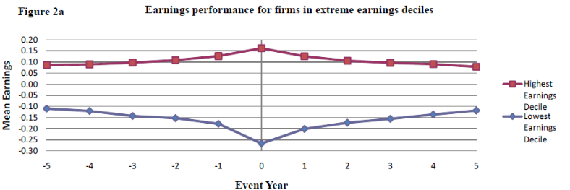
Sloan (1996) Accrual Anomaly

Slide 16
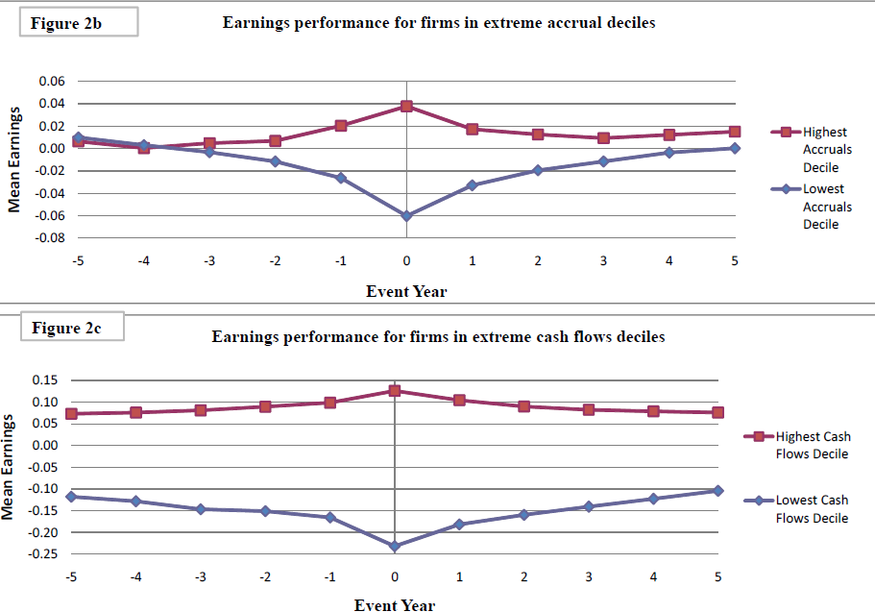
Sloan (1996) Accrual Anomaly

Slide 17
Sloan (1996) Accrual Anomaly
Do investors use information in accruals and cash flows to forecast the persistence of earnings? In other words, do stock prices act as though investors already know that firms with high accruals are likely to experience relatively large drops in future earnings?
Compute accruals for a sample of firm-years from COMPUSTAT
Within each fiscal year, rank observations from lowest to highest based on accruals
Assign firm-years into deciles based on the rank of accruals,
decile 1: lowest-ranked 10%; decile 10: highest-ranked 10%
Compute the subsequent annual stock returns for firm-year observations beginning four (4) months after the fiscal year end
Compute the subsequent annual equally-weighted portfolio returns for each accrual decile

Slide 18
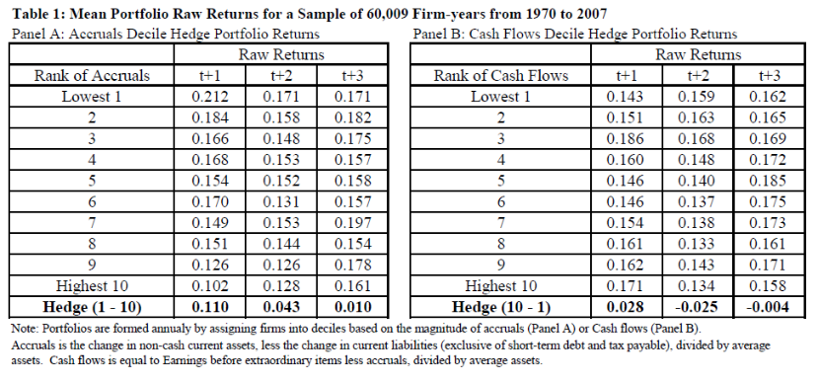
Sloan (1996) Accrual Anomaly

Slide 19
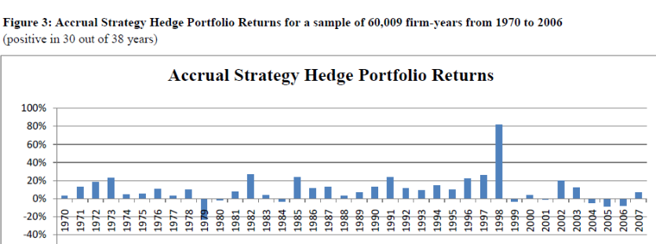
Sloan (1996) Accrual Anomaly

Slide 20
Accrual Anomaly
Do sophisticated financial intermediaries (i.e., analysts, auditors, institutional investors) use information in accruals?
Analysts
Analysts are viewed as sophisticated interpreters of financial information
Sell-side analysts appear to be somewhat oblivious to persistence of accruals
Research has found that analyst earnings forecasts for firms with high accruals are far too optimistic
Auditors
Auditors provide an opinion about whether firms’ earnings fairly present the results of their operations
Research has found no evidence of a higher incidence of auditor qualifications or auditor changes in firms with higher accruals
Institutional investors
There is evidence that institutional investors do trade on the accrual anomaly, but the magnitude of trading (at least 10 years ago) was relatively small
Even though institutional investors dominate the corporate bond market, the accrual anomaly is also robust in bond returns

Slide 21
Accrual Anomaly
Current net operating assets seems to be a limited definition of accruals. What happens when a broader definition is applied?
Using only current non-cash net operating assets: Hedge return is 13.3% per annum (sample specific)
Using all non-cash net operating assets: Hedge return is 18% per annum (sample specific)
Aggregating accruals over two years yields stronger results than using just one year
Where is the accrual anomaly the strongest?
Research has found that inventory accruals exhibit the most robust relation with future stock returns
‘Discretionary’ accruals exhibit a stronger correlation with future returns than do ‘normal’ accruals

Slide 22
Accrual Anomaly
What future events drive the returns to the accrual anomaly?
Extreme inventory accruals are more likely to experience extreme subsequent reversals
High accrual firms are more likely to report negative special items over the next three (3) years
High accrual firms are more likely to be targets of SEC enforcement actions
When low accruals are driven by special items (i.e, write-offs and other unusual negative items), the low accruals are less persistent – earnings will improve more quickly
Is the accrual anomaly robust in other countries?
The accrual anomaly generates positive hedge returns in 85% of countries examined by prior research
Appears stronger in common law (relative to code law) countries

Slide 23
Accrual Anomaly
Is the accrual anomaly still pervasive today? In other words, could I still make money on it?
Yes and No
The very simplistic approach taken by Sloan (1996) has been employed by a large number of hedge funds and other institutional investors, so it has likely been arbitraged away.
However, the basic premise of Sloan’s research still applies today...
Fundamental analysis is likely to yield significant abnormal returns if applied in a robust, rigorous, novel manner
In Sloan’s day, investors appear to have been fixated on reported earnings (rather than earnings quality). Today, although less naïve about the basic components of earnings, investors are still subject to behavioral biases, information overload, limited attention, and other externalities that may prohibit high-quality fundamental analysis.
Opportunities exist for successful trading strategies. You just have to be willing to put in the work and go find them…

Slide 24
Statement of Cash Flows

Slide 25
What is Cash?
Basically, the statement of cash flows explains how the amount of cash on the balance sheet at the beginning of the period became the amount of cash reported at the end of the period. For purposes of this statement, the definition of cash includes cash and cash equivalents. Cash equivalents are short-term, highly liquid investments that are both
Readily convertible to known amounts of cash
So near to maturity there is little risk that their value will change if interest rates change
Generally, only investments with original maturities of three months or less qualify as cash equivalents under this definition. Examples of cash equivalents are Treasury bills (a form of short-term U.S. government debt), money market funds, and commercial paper (short-term notes payable issued by large corporations).

Slide 26
Statement of Cash Flows
The statement of cash flows reports cash inflows and outflows in three broad categories:
Operating
The operating activities section reports the cash inflows and outflows directly related to earnings from normal operations
Investing
The investing activities section reports the cash effects of the acquisition and disposition of assets (other than inventory and cash equivalents)
Financing
The financing activities section reports the cash effects of the sale or repurchase of shares, the issuance or repayment of debt securities, and the payment of cash dividends

Slide 27
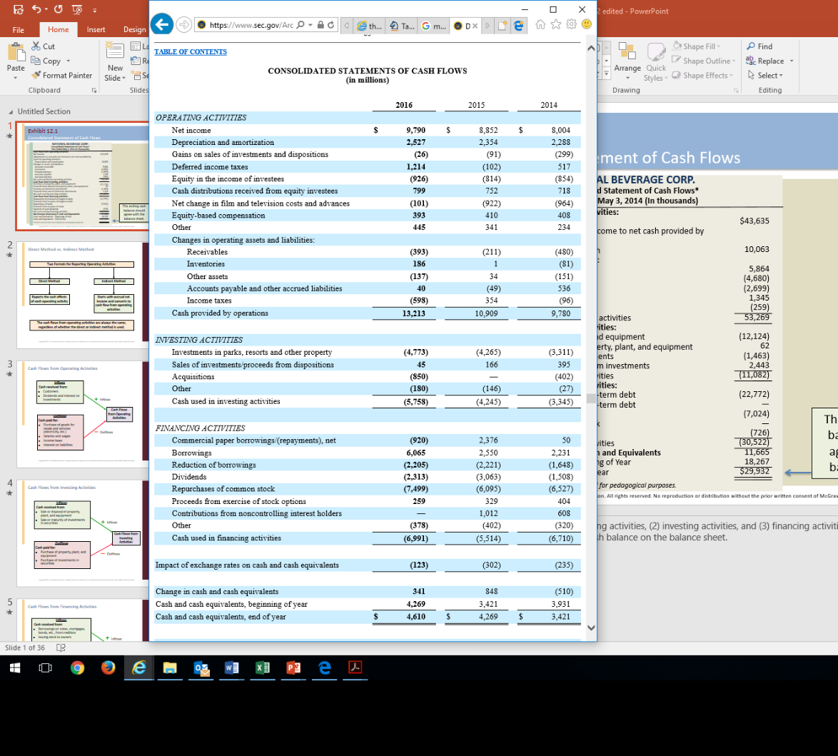

Statement of Cash Flows

Slide 28
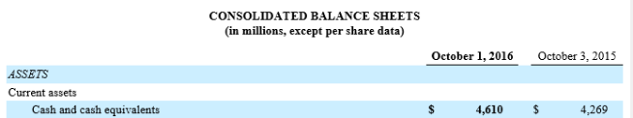
Statement of Cash Flows

Slide 29
Relationship to Balance Sheet and Income Statement
Preparing and interpreting the cash flow statement requires an analysis of balance sheet and income statement accounts that relate to the three sections of the cash flow statement. Preparers must analyze the numbers recorded in the accounts under the accrual method and adjust them to a cash basis.
To prepare a statement of cash flows, preparers need comparative balance sheets, a complete income statement, and additional details concerning selected accounts where the total change amount in an account balance during the year does not reveal the underlying nature of the cash flows.

Slide 30
Relationship to Balance Sheet and Income Statement
Δ Cash = Δ Liabilities + Δ Stockholders’ Equity – Δ Noncash Assets
The change in cash equals the change in liabilities plus the change in stockholders’ equity minus the change in noncash assets. Thus, any transaction that changes cash must be accompanied by a change in liabilities, stockholders’ equity, or noncash assets.
Activity | Transaction | Cash Effect | Other Account Affected
Operating | Collect accounts receivable Pay accounts payable Prepay rent Pay interest Sale for cash | +Cash –Cash –Cash –Cash +Cash | - Accounts Receivable (A) - Accounts Payable (L) + Prepaid Rent (A) - Retained Earnings (SE) + Retained Earnings (SE)
Investing | Purchase equipment for cash Sell investment securities for cash | –Cash +Cash | + Equipment (A) - Investments (A)
Financing | Pay back debt to bank Issue stock for cash | –Cash +Cash | - Notes Payable: Bank (L) + Common Stock and APIC (SE)

Slide 31
Common Cash Flows
Activities | Inflows (cash received from) | Outflows (cash paid for)
Operating | Customers Dividends and interest on investments* | Purchase of goods for resale and services (electricity, etc.) Salaries and wages Income taxes Interest on liabilities*
Investing | Sale or disposal of property, plant, and equipment Sale or maturity of investments in securities | Purchase of property, plant, and equipment Purchase of investments in securities
Financing | Borrowings on notes, mortgages, bonds, etc., from creditors Issuing stock to owners | Repayment of principal to creditors (excluding interest, which is an operating activity) Repurchasing stock from owners Dividends to owners
NOTE: US GAAP and IFRS differ in the cash flow statement treatment of interest received and interest paid. Under US GAAP, interest paid and received are both classified as operating cash flows because the related revenue and expense enter into the computation of net income. IFRS, on the other hand, allows interest received to be classified as either operating or investing and interest paid as either operating or financing. This recognizes that interest received results from investing activities, while interest paid, like dividends paid, involves payments to providers of financing.

Slide 32
Direct and Indirect Methods
There are two acceptable formats for presenting the cash flows from operating activities:
Direct Method
The direct method reports components of cash flows from operating activities as gross receipts and gross payments
Indirect Method
The indirect method adjusts net income to obtain cash flows from operating activities
Note that no matter which format is used, the same amount of net cash flows from operating activities is generated.
Approximately 99 percent of large U.S. companies use the indirect method.

Slide 33
Direct Method

Slide 34
Cash Flow from Operations - Direct Method
 | Cost of Goods Sold
+ | Increase in Inventory
- | Decrease in Inventory
- | Increase in Accounts Payable
+ | Decrease in Accounts Payable
 | Cash Payments to Suppliers
The direct method presents a summary of all operating transactions that result in either a debit or a credit to cash. It is prepared by adjusting each item on the income statement from an accrual basis to a cash basis. For example, when sales are recorded, accounts receivable increases, and when cash is collected, accounts receivable decreases. Thus, to convert sales revenue from the accrual basis to the cash basis, we would add a decrease in accounts receivable or subtract an increase in accounts receivable.
 | Other Expenses
+ | Increase in Prepaid Expenses
- | Decrease in Prepaid Expenses
- | Increase in Accrued Expenses
+ | Decrease in Accrued Expenses
 | Cash Payments for Expenses
 | Sales Revenue
+ | Decrease in Accounts Receivable
- | Increase in Accounts Receivable
 | Cash Collected from Customers
 | Interest / Dividend Revenue
+ | Decrease in Interest / Dividend Receivable
- | Increase in Interest / Dividend Receivable
 | Collections of Interest / Dividends on Investments
 | Income Tax Expense
+ | Increase in Prepaid Income Tax
- | Decrease in Prepaid Income Tax
- | Increase in Income Tax Payable
+ | Decrease in Income Tax Payable
 | Cash Payments for Expenses

Slide 35
Cash Flow from Operations - Direct Method
Consider the following Operating Activities section of the Statement of Cash Flows for Firm X prepared using the direct method. Notice that the net cash provided by operating activities is $53,269, which would be the same amount derived using the indirect method.
Cash flows from operating activities
Cash collected from customers | $646,999
Cash payments to suppliers | (426,815)
Cash payments for other expenses | (146,115)
Cash payments for interest | ( 1,326)
Cash payments for income taxes | ( 19,474)
Net cash provided by operating activities | $ 53,269

Slide 36
Indirect Method

Slide 37
Reporting Cash Flow from Operations
Virtually all U.S. companies choose the indirect method. Remember that the indirect method starts with net income and converts it to cash flows from operating activities. This involves adjusting net income for the differences in the timing of accrual basis net income and cash flows.
Net Income
+ Noncash expenses such as depreciation and amortization
+ Losses
- Gains
+/− Changes in current assets and current liabilities
Cash Flows from Operating Activities
* Transactions that cause gains and losses should be classified on the statement of cash flows as operating, investing, or financing activities, depending on their dominant characteristics.

Slide 38
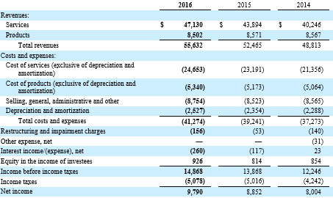
Cash Flow from Operations - Indirect Method
Adjust net income for depreciation and amortization expense
Adjust net income for gains and losses
Adjust net income for changes in current assets and current liabilities
Add the change when an operating asset decreases or an operating liability increases
Subtract the change when an operating asset increases or an operating liability decreases
The statement of cash flows begins with net income from the income statement.

Slide 39
Changes in A/R and A/P
The overall decrease of $5,864 in accounts receivable is reflected on the cash flow statement as an inflow of cash.
Accounts Receivable (A)
BB | $ 64,069 | $
Sales Revenue (on account) | 641,135 | 646,999 | Collections from customers
EB | $ 58,205
Change: $5,864
Accounts Payable (L)
 | $ | $ | BB
Cash Payments |  |  | Purchases (on account)
 | $ |  | EB
If A/P decreases (increases), then a cash outflow (inflow) occurred

Slide 40
Adjustment for Gains and Losses
Example:
Property, plant, and equipment with an original cost of $10,000 and accumulated depreciation of $4,000 is sold for $8,000 cash.
Because the gain is included in the computation of income, it is necessary to remove (subtract) the $2,000 gain from the Operating Activities section of the statement to avoid double counting
The $8,000 cash received from the sale is reported as an investing cash inflow
To record asset sale | Debit | Credit
Cash (+A) | $8,000
Accumulated Depreciation (-CA; +A) | 4,000
Property, Plant, and Equipment (-A) |  | $10,000
Gain on Disposal (+Gain; +SE) |  | 2,000

Slide 41
Interpreting Cash Flow from Operations
The operating activities section of the SCF focuses attention on the firm’s ability to generate cash internally through operations and its management of current assets and current liabilities (also called working capital). Many analysts believe that this is the most important section of the statement because, in the long run, operations are the only source of cash.
investors may be less willing to invest in a company if they do not believe that cash generated from operations will be available to pay them dividends or expand the company
creditors may be less likely to lend money if they do not believe that cash generated from operations will be available to pay back the loan
Firms with rising net income but falling cash flow from operations may be experiencing difficulty. Rapidly rising inventories or receivables often predict a slump in profits and the need for external financing. A true understanding of the meaning of the difference requires a detailed understanding of its causes.

Slide 42
Cash Flow from Investing Activities

Slide 43
Interpreting Cash Flow from Investing Activities
Preparing this section of the cash flow statement requires an analysis of the accounts related to property, plant, and equipment; intangible assets; and investments in the securities of other companies.
Remember that:
Only purchases paid for with cash or cash equivalents are included
The amount of cash that is received from the sale of assets is included, regardless of whether the assets are sold at a gain or loss
Activities | Inflows (cash received from) | Outflows (cash paid for)
Operating | Customers Dividends and interest on investments | Purchase of goods for resale and services (electricity, etc.) Salaries and wages Income taxes Interest on liabilities
Investing | Sale or disposal of property, plant, and equipment Sale or maturity of investments in securities | Purchase of property, plant, and equipment Purchase of investments in securities
Financing | Borrowings on notes, mortgages, bonds, etc., from creditors Issuing stock to owners | Repayment of principal to creditors (excluding interest, which is an operating activity) Repurchasing stock from owners Dividends to owners

Slide 44
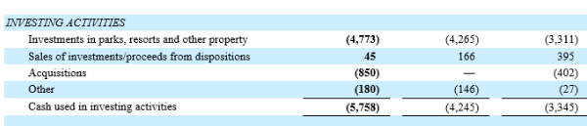
Statement of Cash Flows
We must report individually the cash used to purchase equipment and the cash proceeds received from the sale of equipment.
Although short-term investments is a current asset, it is reported in the investing section on the statement of cash flows.

Slide 45
Cash Flow from Financing Activities

Slide 46
Interpreting Cash Flow from Financing Activities
Financing activities are associated with generating capital from creditors and owners. This section of the SCF reflects changes in two current liabilities: notes payable to financial institutions (often called short-term debt) and current maturities on long-term debt, as well as changes in long-term liabilities and stockholders’ equity accounts. These balance sheet accounts relate to the issuance and retirement of debt and stock and the payment of dividends.
Remember that:
Cash repayments of principal are cash flows from financing activities
Interest payments are cash flows from operating activities
Dividend payments are cash flows from financing activities
If debt or stock is issued for other than cash, it is not included in this section
Activities | Inflows (cash received from) | Outflows (cash paid for)
Operating | Customers Dividends and interest on investments | Purchase of goods for resale and services (electricity, etc.) Salaries and wages Income taxes Interest on liabilities
Investing | Sale or disposal of property, plant, and equipment Sale or maturity of investments in securities | Purchase of property, plant, and equipment Purchase of investments in securities
Financing | Borrowings on notes, mortgages, bonds, etc., from creditors Issuing stock to owners | Repayment of principal to creditors (excluding interest, which is an operating activity) Repurchasing stock from owners Dividends to owners

Slide 47
Interpreting Cash Flow from Financing Activities
The long-term growth of a company is normally financed from three sources: internally generated funds (cash from operating activities), the issuance of stock, and money borrowed on a long-term basis.
Companies can adopt a number of different capital structures (the balance of debt and equity). The financing sources that management uses to fund growth will have an important impact on the firm’s risk and return characteristics. The statement of cash flows shows how management has elected to fund its growth. This information is used by analysts who wish to evaluate the capital structure and growth potential of a business.

Slide 48
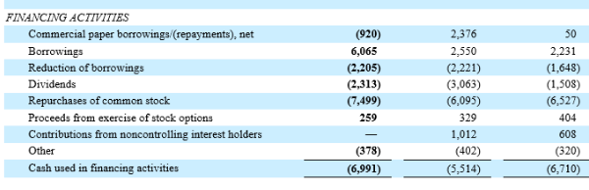
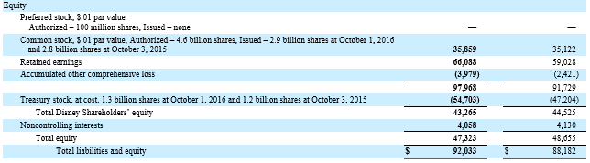
Statement of Cash Flows
DIS’ change in contributed capital resulted from repurchasing $7,499m of outstanding stock during the year.

Slide 49
Statement of Cash Flows
DIS’ change in Retained Earnings resulted from the combined effect of $9,391m of net income and $2,313m in dividends declared and paid.

Slide 50
Additional Disclosures

Slide 51
Completing the SCF
Additional Required Disclosures:
Reconciliation of net income to cash flow from operations
Noncash investing and financing activities
Cash paid for interest and income taxes
Certain transactions are important investing and financing activities but have no cash flow effects. These are called noncash investing and financing activities. For example, the purchase of a $100,000 building with a $100,000 mortgage given by the former owner does not cause either an inflow or an outflow of cash. As a result, these noncash activities are not listed in the three main sections of the statement of cash flows. However, supplemental disclosure of these transactions is required, in either narrative or schedule form.
Companies that use the indirect method of presenting cash flows from operations also must provide two other figures: cash paid for interest and cash paid for income taxes. These are normally listed at the bottom of the statement or in the notes.

Slide 52
Ratio Analysis

Slide 53
Quality of Income Ratio
How much cash does the firm generate from income?
In general, this ratio measures the portion of income that was generated in cash. All other things equal, a higher quality of income ratio indicates greater ability to finance operating and other cash needs from operating cash inflows.
All other things equal, a higher quality of income ratio indicates greater ability to finance operating and other cash needs from operating cash inflows. A higher ratio also indicates that it is less likely that the company is using aggressive revenue recognition policies to increase net income and therefore is less likely to experience a decline in earnings in the future. When this ratio does not equal 1.0, analysts must establish the sources of the difference to determine the significance of the findings.
Cash Flow from Operations
Net Income
=
Quality of Income Ratio

Slide 54
Capital Acquisitions Ratio
How well can management finance acquisitions with internal cash flow?
In general, this ratio reflects the portion of purchases of property, plant, and equipment financed from operating activities. A high ratio indicates less need for outside financing for current and future expansions.
The capital acquisitions ratio reflects the portion of purchases of property, plant, and equipment financed from operating activities (without the need for outside debt or equity financing or the sale of other investments or fixed assets). A high ratio indicates less need for outside financing for current and future expansion. It benefits the company because it provides opportunities for strategic acquisitions, avoids the cost of additional debt, and reduces the risk of bankruptcy that comes with additional leverage.
Cash Flow from Operations
Cash paid for PP&E
=
Capital Acquisitions Ratio

Slide 55
Free Cash Flow
How well can management finance investment opportunities with internal cash flow?
In general, this measures a firm’s ability to pursue long-term investment opportunities.
Any positive free cash flow is available for additional capital expenditures, investments in other companies, and mergers and acquisitions without the need for external financing or reductions in dividends to shareholders.
While free cash flow is considered a positive sign of financial flexibility, it also can represent a hidden cost to shareholders. Sometimes managers use free cash flow to pursue unprofitable investments just for the sake of growth or to obtain perquisites (such as fancy offices and corporate jets) that do not benefit the shareholders. In these cases, the shareholders would be better off if free cash flow were paid as additional dividends or used to repurchase the company’s stock on the open market.
Free Cash Flow
=
Cash Flow from Operations – Dividends – Capital Expenditures

Slide 56
End of Chapter 12

